Slide 1
Title Here
Your Name Here
PNSQC 2021

Slide 3
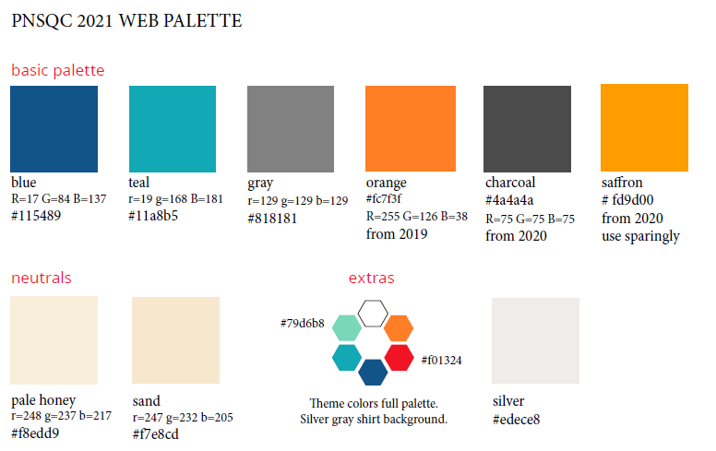
Prefer use of Calibri font, with body font size being no smaller than 18.

